Slide 1
Data Wizards Project #2
By Di Chen, Mai Castellano, Spencer Hutchison & Tyler Kussee
Notes:
Tyler

Slide 2
Explanation Of The Data
This data comes from Kaggle Vehicle Loan Default Prediction Challenge.
This dataset contains a diverse set of information on individuals ranging from their birth date and employment status to their credit and size of their loan.
The purpose of the challenge was to accurately predict the probability of loanee defaulting on a vehicle loan.
Notes:
Tyler

Slide 3
Questions of Interest
What are the most influential explanatory variables?
Which parameters are the most effective with the training data?
Out of the models we trained, which one is most effective with the test data?
Notes:
Tyler

Slide 4
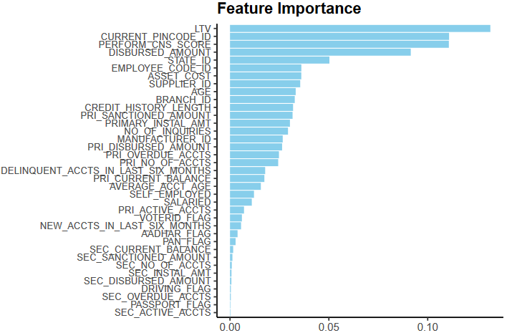
Question 1: What are the most influential explanatory variables?
We utilized the XGBoost Machine Learning Algorithm and log loss metrics to find these variables.
The top 15 included: The loan to value ratio, Current Pincode ID, CNS Score (Credit Rating), dispersed amount, state ID, the cost of the car, the suppliers ID, the PRI sanctioned amount, the employee who offered the loan, the branch where it was loaned, the credit history length, age of the loanee, number of credit inquiries, number of PRI overdue accounts, and the initial installment amount on the vehicle.
Notes:
Cindy

Slide 5
Question 1: Interpretation
Loan amount and the value of the asset or vehicle in this case is extremely important. They make of 4 of the most important variables.
Loanee information: Credit information such as how long their history is and their credit rating make sense, and state ID might be correlated with age.
Branch Information: This is interesting because it would indicate that there are certain branches and employees within those branches that are either a bad judge of financial character or are not fiscally minded.
Notes:
Cindy

Slide 6
Question 2: Which parameters are the most effective with the training data?
Trained two XGBoost models with various learning rates (eta) from 1 to 0.01. Used 100 boosting rounds and maximum depth of 6. The lowest log loss was at eta = 0.01.
Model Performance at Threshold 0.5: Accuracy: 78.32%, Precision: 77%, Recall: 0.059% (low, missing many actual positive cases).
Model Performance at Threshold 0.4: Accuracy: 78.08%, Precision: 45.99%, Recall: 6.11% (slightly higher but still low).
Notes:
Mai

Slide 7
Question 2: Interpretation
Overall, this model does not improve accuracy nor precision, similar limitations in capturing all positive cases compared to the previous
When we set the threshold at 0.6, the model did not predict any instances as belonging to defaulting class.
Notes:
Mai

Slide 8
Question 3: Out of the models we trained, which one is most effective with the test data?
When testing against the validation we adjusted the threshold to 0.4 and the model maintain consistent overall prediction and accuracy with 78% and 44.3% respectively while recall showed a slight improvement to 5.2%.
Setting the threshold to 0.6 still results in the model failing to predict any instances belonging to the defaulting class, similar to the behavior observed in the initial model.
Using ROC curve to find the different thresholds to be used 0.3 was determined to have the best recall, but resulted in accuracy decreasing significantly to 51.6%.
Notes:
Spencer

Slide 9
Question 3: Interpretation
Despite remodeling the data and adjusting the threshold, the challenge of capturing all positive cases persists.
Even when looking for other parameters to change the tradeoffs were very significant and would need much more research to find more optimal settings.
Notes:
Spencer

Slide 10
Obstacles & Solutions
Code changes still had conflicts within our repository.
We reached an agreement that each team member must have their changes reviewed by another team member before merging the branches.
Notes:
Mai

Slide 11
Future Work/Improvements
The prediction model exhibited a high rate of accuracy and moderate precision, but the recall was extremely low and that poses significant limitations for loan default application.
There is significant need for improvement within the model and parameters in order to improve its practicality and real world use cases.
Notes:
Cindy

Slide 12
Conclusion
While this model was very difficult to improve upon we learned a lot about the XGBoost machine learning algorithm.
This model has shown us that every dataset has their own intricacies and some are more suited for different approaches to modeling and prediction.
Notes:
Tyler

